Slide 1


Playing Games and Solving Puzzles using AI
Dimitar Seraffimov
A presentation submitted in part fulfilment of the degree of
BSc in Computer Science with Software Engineering
Supervisor: Magnus Wahlstrom

Slide 2
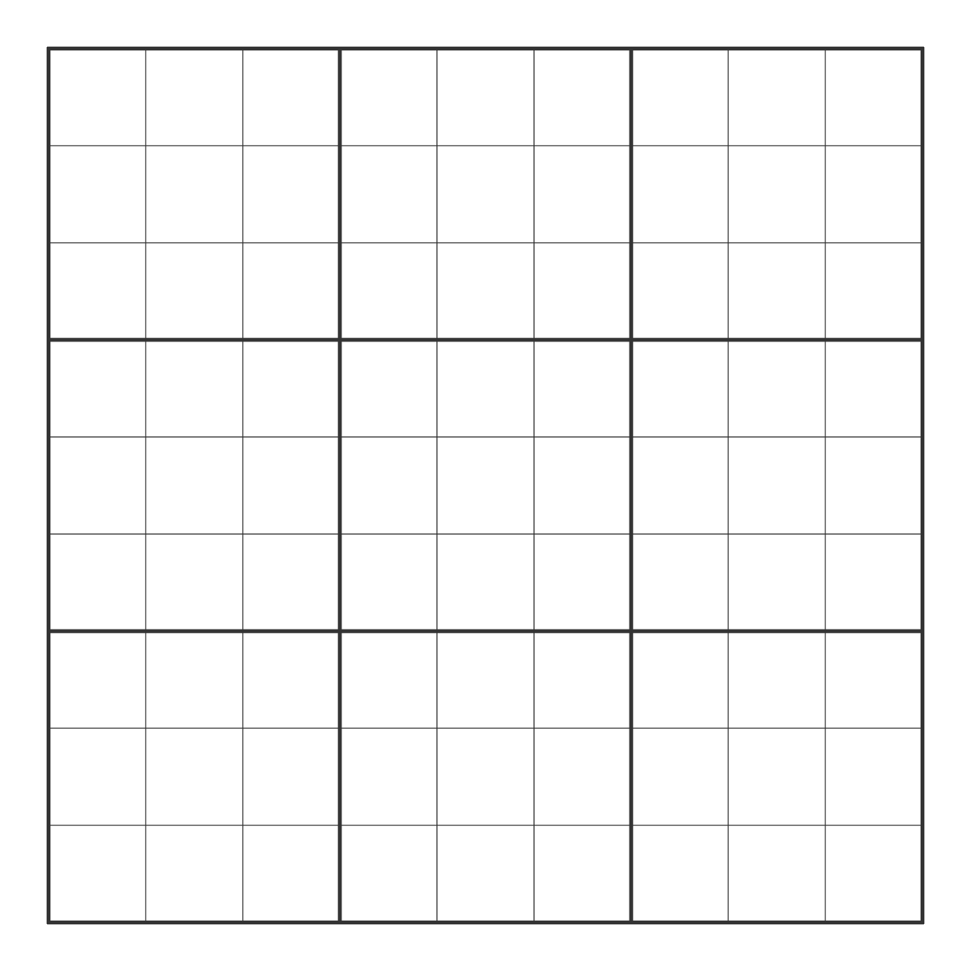
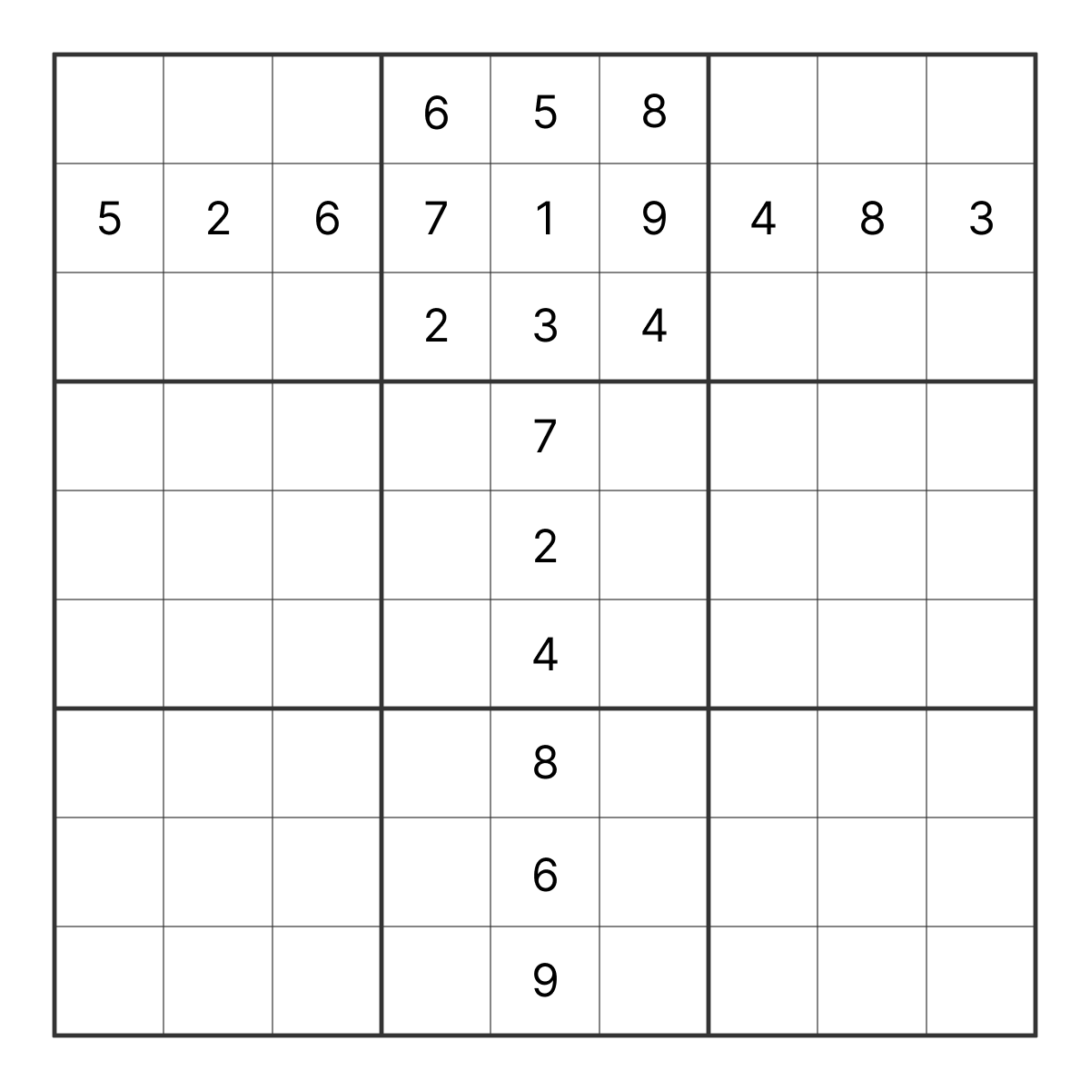
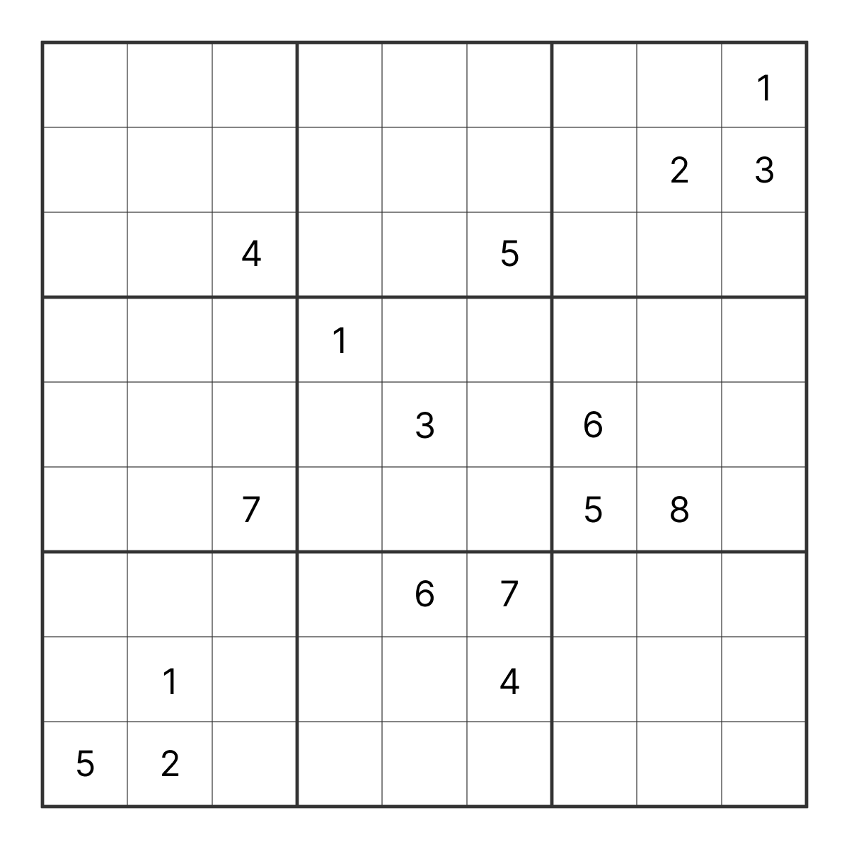
Sudoku Mobile App
An empty Sudoku grid
Partially completed grid
???
Puzzle with 17 clues
(extreme level)

Slide 3
Aims & Objectives
Harmonie in Design & Software:
balance between seamless user experience and
professionally implemented back-end software
Minimalist Design Philosophy:
minimalist yet effective principles and
processes in the application's design
Sudoku Puzzle Generation and Difficulty Levels:
generating unique Sudoku puzzles with various difficulty levels, ensuring endless game variants

Slide 4
Enhanced In-Game Functionalities:
key functionalities like puzzle validation, hints, step-back option, and time tracking to boost user engagement and competitive play
Difficulty Level | Empty Cells
1 (Easy) | 40 to 45
2 (Medium) | 46 to 49
3 (Hard) | 50 to 53
4 (Extreme) | 54 to 58
Future Extension to Machine Vision:
plan to explore integration of machine vision for inputting new puzzles - aiming to add advanced user interactions and technological complexity
Empty Cells for each Difficulty Level [1]

Slide 5
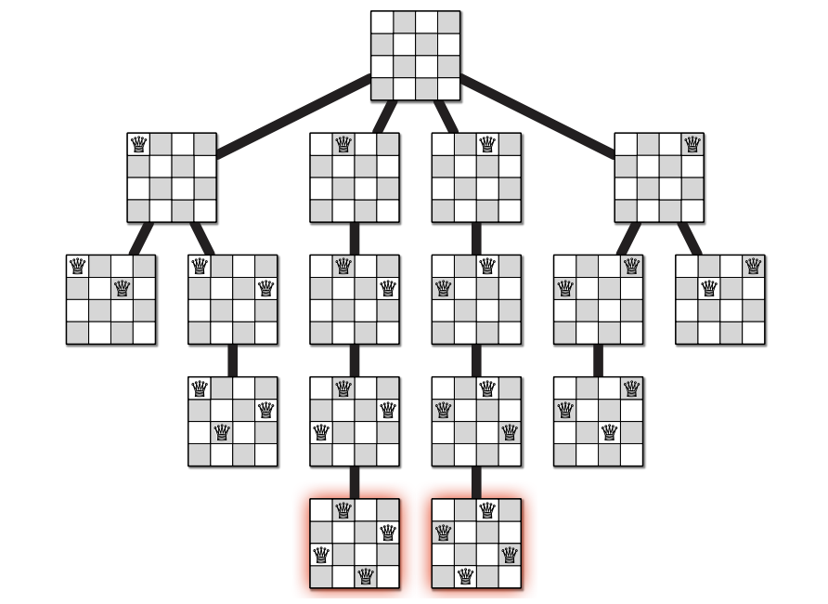
Theoretical Analysis
N-Queens Problem, 1st PoC Program
classic problem, placing N number of queens on an N×N chessboard without mutual threats
illustrates the implementation of recursive backtracking
demonstrates algorithm's ability to explore all possible configurations
Image Source [2]

Slide 6
Theoretical Analysis Backtracking Algorithm - 3rd PoC Program
Implementing Backtracking algorithm is the key to
exhaustive search programs correctly and efficiently.
Explained in simple terms, backtracking is a special
approach to problem-solving that involves:
depth-first search on an implicit graph of configurations;
exploring all possible solutions to a problem;
eliminating those solutions that fail to satisfy the constraints;
"backtracking" to a previous step and trying alternative solutions.

Slide 7
Theoretical Analysis User Interface Theory - 2nd PoC Program
UML Diagrams:
utilizes UML diagrams for a structured visual representation of the system’s architecture
User Stories:
help maintain a human-centric approach, aligning the development with end-user preferences
Agile Methodology Influence:
Agile methodologies [3] influenced the GUI design process by keeping development concise
Practical Application of Knowledge:
applied methods, learned in "CS2800: Software Engineering" to the project’s core development

Slide 8
Future Development
Automated Puzzle Generation:
creating fully completed Sudoku puzzles and then removing
cells to form the puzzle grid
classify puzzles into four difficulty levels:
Easy, Medium, Hard, Extreme
Unique Solution Assurance:
ensuring each generated puzzle has a unique solution
Validation Option:
enable players to compare their solutions with the correct one,
highlighting errors
Hints and Complete Solutions:
hints and full solutions to maintain game accessibility
across different skill levels

Slide 9
Software Engineering
Python & React Native
Expo Framework
UML design & User Stories

Slide 10
Thank you for your attention!

Slide 11
References:
[1] Lee, W.M., 2006. Programming Sudoku. Apress.
[2] Image Source:
https://codeahoy.com/learn/recursion/ch10/
[3] Fowler, M. and Highsmith, J., 2001.
The agile manifesto. Software development, 9(8), pp.28-35.

